Slide 1
Black Jack Phase 1
-Requirements-
By Nikolas, Oscar, Carolina, Matthew, Santiago, and Brandon

Slide 2
Top 10 Requirements
System will follow standard Blackjack rules
Players will be able to play accordingly, and be paid accordingly based on the outcome of the game
System will define what a User may be able to do based on the Role linked with the account (Dealer, Player)
Depending on the role of the User, they will be shown different GUI options to interact with the program (Ability to hit, stand, draw cards, etc)
System must have a way to hold a set of “Tables” which contain a game, holding Users
User accounts will be pre-set with Dealer or Player roles linked to the accounts
Login and Logout features, Withdraw and Balance methods
Only dealers will be able to create “Tables” to host a game
Dealers are the only one who can decide whether or not to begin a game at a Table
Players must be able to leave and join Tables appropriately without disrupting a current game
A turn based system must be implemented to ensure no overlap
The current deck of cards should be reshuffled once a limit is reached to use a fresh deck

Slide 3
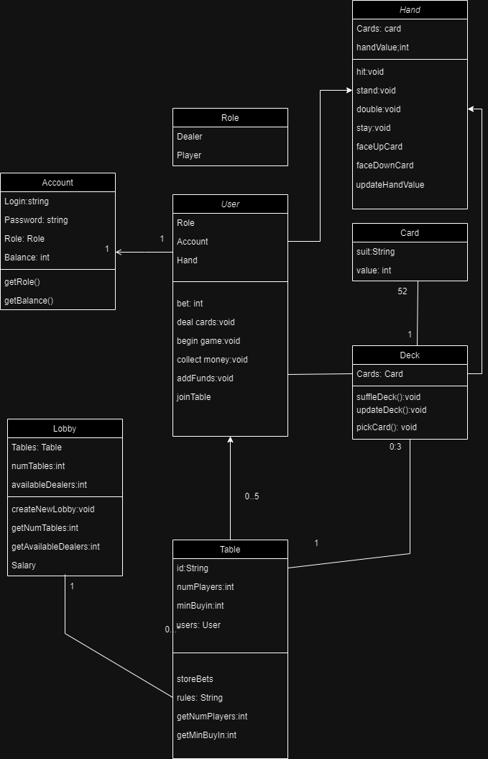
Top 5 class candidates
Account
The class in which a user can interact that does not involve an active game
Holds login information, role, and balance
Every account is preset with a role, cannot be changed
User
Class which will be used during the Blackjack game
Can be defined as a “Player” or “Dealer”
Can update personal balance outside of games
Linked to 1 Account object
Hand
The array of Card objects that user contains
Used by User to call game methods (Hit, Stand, etc.)
Deck
The array of Card used to draw cards
Lobby
The list in which it holds tables which hold separate games for players to join

